Slide 1
Siri Singh Sahib Corporation
Executive Director’s Report

Slide 2
Review of First Term
Building of SSSC Infrastructure
Regular Meetings
Committee Structure
Staffing
Review and Updating of SSSC Bylaws
Constituent Board Repopulations
Funding of Chateau Anand
Partnered with local community to purchase 1622 Preuss Road Property (next to GRDA, Los Angeles)

Slide 3
Activity Since April
Bylaw updates
Participation in CEO Meetings
Begun standardization of Articles and Bylaws across Constituent Organizations
Begun review of policies across all Constituent Organizations
Begun CCC process
Begun Strategic Thinking Process at SSSC level
Formalization and Implementation of Election Policy

Slide 4
Link to Bylaws
https://sirisinghsahibcorp-public.sharepoint.com/articles-policies-and-bylaws

Slide 5
CCC Update
Grant Requests

Slide 6
2015 Grant Requests
TOTAL OF PROPOSALS: $3,010,315
AMT. PROJECTED TO BE DISTRIBUTED:$2,000,000
LYF: $426,393
SDEI: $387,000
SDI: $322,158
3HO: $230,000
KRI: $439,000
SikhNet: $175,000
SSS of SD: $69,200
3HO Europe: $358,000
Ethics & Professional Standards Position: $79,937
Museum Project: $150,000
Legacy Salaries: $373,627

Slide 7
Strategic Thinking Initiative
Building the Future

Slide 8
Strategic Thinking
Special SSSC Strategy and Alignment Sub-Committee Formed
Discover Core Values and Core Purpose
Develop 20-year “Mount Everest” Grand Vision
Collaborate with constituent nonprofits and for-profits to align holistic goals
Determine 3 year to 5 year Priorities
Develop Annual Strategies
Work together to build our future

Slide 9
SSSC Board Elections
2015 Election

Slide 10
Qualifications for Board Membership (from bylaws)
Section 2.6 Qualifications for board membership
To be eligible to serve as an Elected Trustee an individual must:
(a) be ordained as a minister of Sikh Dharma International at least two (2) full years immediately preceding his or her nomination and be currently in good standing;
(b) be a regular donor to one or more of the nonprofit Constituent Corporations (as defined in Section 1.4) and has been for at least two (2) calendar years immediately preceding his or her nomination

Slide 11
Qualifications for Board Membership (from bylaws)
(c) be of good character; have never been convicted of or admitted to any felony offense or a misdemeanor involving moral turpitude; not represent any threat to the security of the United States or have any foreign interests or status that conflict with the interests of the United States or with any element of the Sikh Dharma/3HO Community and businesses; agree to provide information for a confidential background check; and
(d) not concurrently serve as a voting member of the Board of Directors of any non-profit Constituent Corporation identified on Exhibit A to these Bylaws. In order to comply with this:

Slide 12
Qualifications for Board Membership (from bylaws)
(i) A Trustee must either resign or continue as a non-voting member of the Board of Directors of a non-profit Constituent Corporation immediately upon taking office as Trustee, (note California corps. do not have non-voting directors- KRI, 3HO, and SDI)
(ii) A Trustee may serve in a non-voting capacity on a maximum of two (2) nonprofit Constituent Corporation boards.
(iii)If applicable, a Trustee serving a non-profit Constituent Corporation in a non-voting capacity may be recused from SSSC votes on issues involving that subject constituent
(e) not be related by blood or marriage (including step-relations) to, or in a domestic partnership with, another Trustee.

Slide 13
Electorate (from policy)
For the 2015 election, the eligible Electorate is:
1. Ministers of Sikh Dharma in good standing fourteen (14) days prior to the start of voting, and
2. Voters who voted in the Initial Board Election, as listed in Exhibit A.
For all subsequent elections, the eligible Electorate is only Ministers of Sikh Dharma who are in good standing ninety (90) days prior to the start of voting.

Slide 14
Election Term (from bylaws)
Section 2.4 Term and Election.
The terms of Elected Trustees shall be five (5) years. Elections shall be staggered with one-half of the Trustees elected at approximately 2.5 year intervals. The election process shall be as specified in the SSSC Board Election Policy adopted by resolution of the Board of Trustees from time to time. Each Trustee shall hold office until his/her term expires and until his/her successor has been elected and qualified unless sooner terminated pursuant to Section 2.7. Trustees may serve consecutive terms. The vacancy created by the expiration of the term of a Trustee shall be filled as specified in Section 2.8. The term of the Initial SSSC Board shall be as specified in the SSSC Board Election Policy.

Slide 15
Election Term (from policy)
The term of office for seven (7) of the Initial SSSC Board Members ("Group A") shall expire on the first day of the Spring Khalsa Council meetings in 2015. The term of office for the remaining eight (8) elected Initial SSSC Board("Group B") shall expire on the first day of the Fall Khalsa Council meetings in 2017. Group A and Group B shall be designated on a volunteer basis. If either group receives fewer volunteers than necessary, the remaining Board Members for that group shall be selected at random.
Terms that begin during the Spring Khalsa Council meetings shall expire on the first day of the Spring Khalsa Council meetings approximately five (5) years later. Terms that begin during the Fall Khalsa Council meetings shall expire on the first day of the Fall Khalsa Council meetings approximately five (5) years later.

Slide 16
Election Schedule and Procedures (from policy)
The election is divided into twelve (12) phases as outlined below. Unless otherwise specified, the following rules apply to every phase of the Election:
* The Office of the Executive Director shall administer all procedures and communications.
* Communications and notifications shall be made by email.
* For the purposes of this Policy, Sangat is defined as members of the SSSC email list and anyone aware of the information sent to the SSSC email list.
* Phases of the election run consecutively without interruption.

Slide 17
Phases of the 2015 Election
1. Announcement – Already announced
2. Nomination – October 1-31
3. Vetting – November 1-30
4. Announcement of Candidates – Dec 1
5. Submission of Candidate Statements – Dec 2 to Jan 10
6. Posting of Reviewed Candidate Statements – Jan. 26 or earlier

Slide 18
Phases of the 2015 Election
7. Voting Begins- Jan 27
8. Voting Ends- Feb 9
9. Vote Tally – Feb 10
10. Run-Off Election (If Necessary) – Feb 11-25
11. Notify Sangat of the Election Results – March 1 or earlier
12. Assumption of Office - First day of Spring Khalsa Council (expected date April 23, 2015)

Slide 19
SSSC Members’ Terms
Staggered terms of 2.5 years
Per bylaws 7 members’ terms will end in 2015
Continuity and stability
Retain Institutional knowledge
SSSC Members Terms Ending in 2015
Volunteers and Random Selections
SSSC Members may run again if nominated

Slide 20
Ex-Officio Members of the SSSC
Permanent Members
Bhai Sahiba Bibiji Inderjit Kaur
Siri Sikdar Sahiba Sardarni Guru Amrit Kaur Khalsa

Slide 21
Group A - Members’ Terms Ending in 2015
SS Gurujodha Singh Khalsa
SS Viriam Singh Khalsa
MSS GuruRaj Kaur Khalsa
SS Dharm Singh Khalsa
SS Harinam Singh Khalsa
MJ Amrit Singh Khalsa
SS Gurujot Kaur Khalsa

Slide 22
Group B - Members’ Terms Ending in 2017
SS Dr. Harjot Kaur Singh
SS Siri Pritam Kaur Khalsa
SS Jai Singh Khalsa
SS Siri Vishnu Singh Khalsa
MSS Guru Singh Khalsa
MSS Krishna Kaur Khalsa
SS Guru Amrit Singh Khalsa
SS Avtar Hari Singh Khalsa

Slide 23
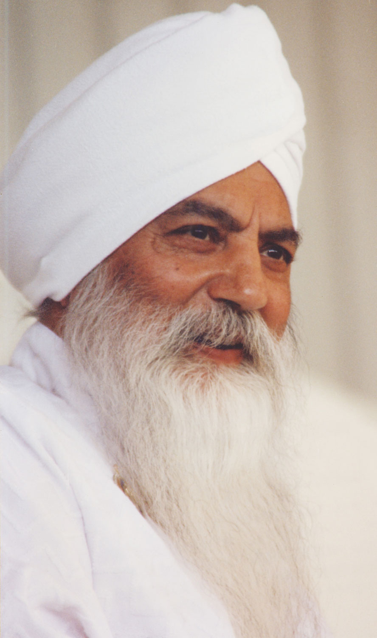
“… leader means taking the risk. Leader means going from the finite to the infinite. Leader means putting the self on the side and jumping for all sides. Leader means not reaching but reaching out.”
Siri Singh Sahib
Yogi Bhajan

